Slide 1
AI PROJECT
WORKSHOP FEEDBACK ANALYSIS
KEEGAN PAUL COLACO - 101
S.SHIVRAM PRASADH - 116
KAVIN NANDHA.M - 100

Slide 2
Introduction
Workshop Analysis:
This model is used to receive feedback (in the form of text) about a workshop. The review is taken from the people who attend the workshop and it is analyzed by the model.
It is a natural language processing (NLP) technique used to determine whether data is positive or negative.
Feedback analysis is often performed on textual data to help businesses monitor brand and product sentiment in customer feedback, and understand customer needs.

Slide 3
Dataset
We have used the IMDB dataset for movie reviews from Kaggle.
This dataset contains two columns:
Review
Sentiment
For our use case here, we have performed data preprocessing on the dataset in order to achieve the relevant data for our problem statement.
There are fifty thousand rows in the dataset which is used to train the model.

Slide 4
Imported Libraries
nltk - NLTK is a leading platform for building Python programs to work with human language data.
random - It is a module that allows us to make random numbers.
pickle - It is used for serializing and de-serializing a Python object structure.
pandas - pandas is a software library written for the Python programming language for data manipulation and analysis.

Slide 5
Imported Libraries
statistics - This module provides functions for calculating mathematical statistics of numeric data.
nltk.corpus - The modules in this package provide functions that can be used to read corpus files in a variety of formats.
nltk.tokenize - Tokenizers divide strings into lists of substrings. For example, tokenizers can be used to find the words and punctuation in a string.

Slide 6
Methodology
A) Data Cleaning
B) Tokenization
C) Vectorization/Word Embedding
D) Model Development

Slide 7
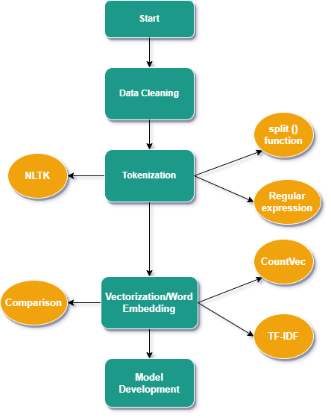
System Flow Diagram

Slide 8
Data Cleaning
Remove stopwords
Bag of Words
Make lower case
Lemmatization
Stemming
Removal of regular expressions
Parts-of-Speech (POS) tagging
Named-Entity-Recognition (NER)

Slide 9
Tokenization
Tokenization using split () function: Returns list of strings after breaking the given string by the specified separator. By default, a separator is a space.
Tokenization using Regular expression: Returns list based on the regular expressions.
Tokenization using NLTK: Includes different types of tokenizers under NLTK package

Slide 10
Vectorization/Word Embedding
CountVec: Count number of times a particular word appears in the document. CountVectorizer helps to get this count.
TF-IDF: Term frequency Inverse document frequency (TF-IDF) provides an overall weightage of a word in the document. TfidfVectorizer helps to get this weighted score.
Comparison: CountVec might provide biased results in favour of most frequent words. This ignores the rare words which might have higher importance.

Slide 11
Model Development
We can use any of the classification models like logistic regression, random forest (RF), support vector machines (SVM) or any deep learning models to predict the label.
As a measure of accuracy, F1-score can be used based the problem statement in hand.

Slide 12
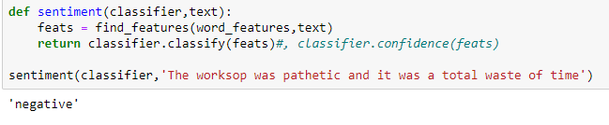
Results
When a negative statement is given as an input, the model returns the result as ‘negative’.

Slide 13
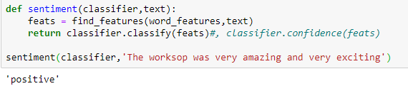
Results
When the input is positive, the model returns the result as ‘positive’.
THE ACCURACY WAS FOUND TO BE 82.17%

Slide 14
Conclusion
Sentiment analysis can be applied to countless aspects of business, from brand monitoring and product analytics, to customer service and market research. By incorporating it into their existing systems and analytics, leading brands (not to mention entire cities) are able to work faster, with more accuracy, toward more useful ends.

